Slide 1

SCC331 group 5 (super coders) user testing
SPRINT 5

Slide 2
REASONS FOR OUR RESEARCH
We are thrilled to share the findings from our user testing research for the webpage and app for scc311 group 5 project sprint 5. This webpage/app was created with the intention of giving users a smooth and entertaining experience while monitoring where people are in the prison , number of people in each building and environmental changes e.g temperature. The webpage/app will also make charts and stats on the environmental changes as an extra functionality. I am writing to provide you some background on the purpose of our [App/Webpage] user testing. It is essential for members of the development team to comprehend the importance of user testing and how it affects the project's outcome.

Slide 3

Research findings:
.
six individuals who were not involved in the development or prior use of the webpage/app were assembled. In order for us to make our conclusions, they were told to use the webpage/app and provide five options in response to ten questions. We gathered another six separate individuals for both the webpage and app

Slide 4
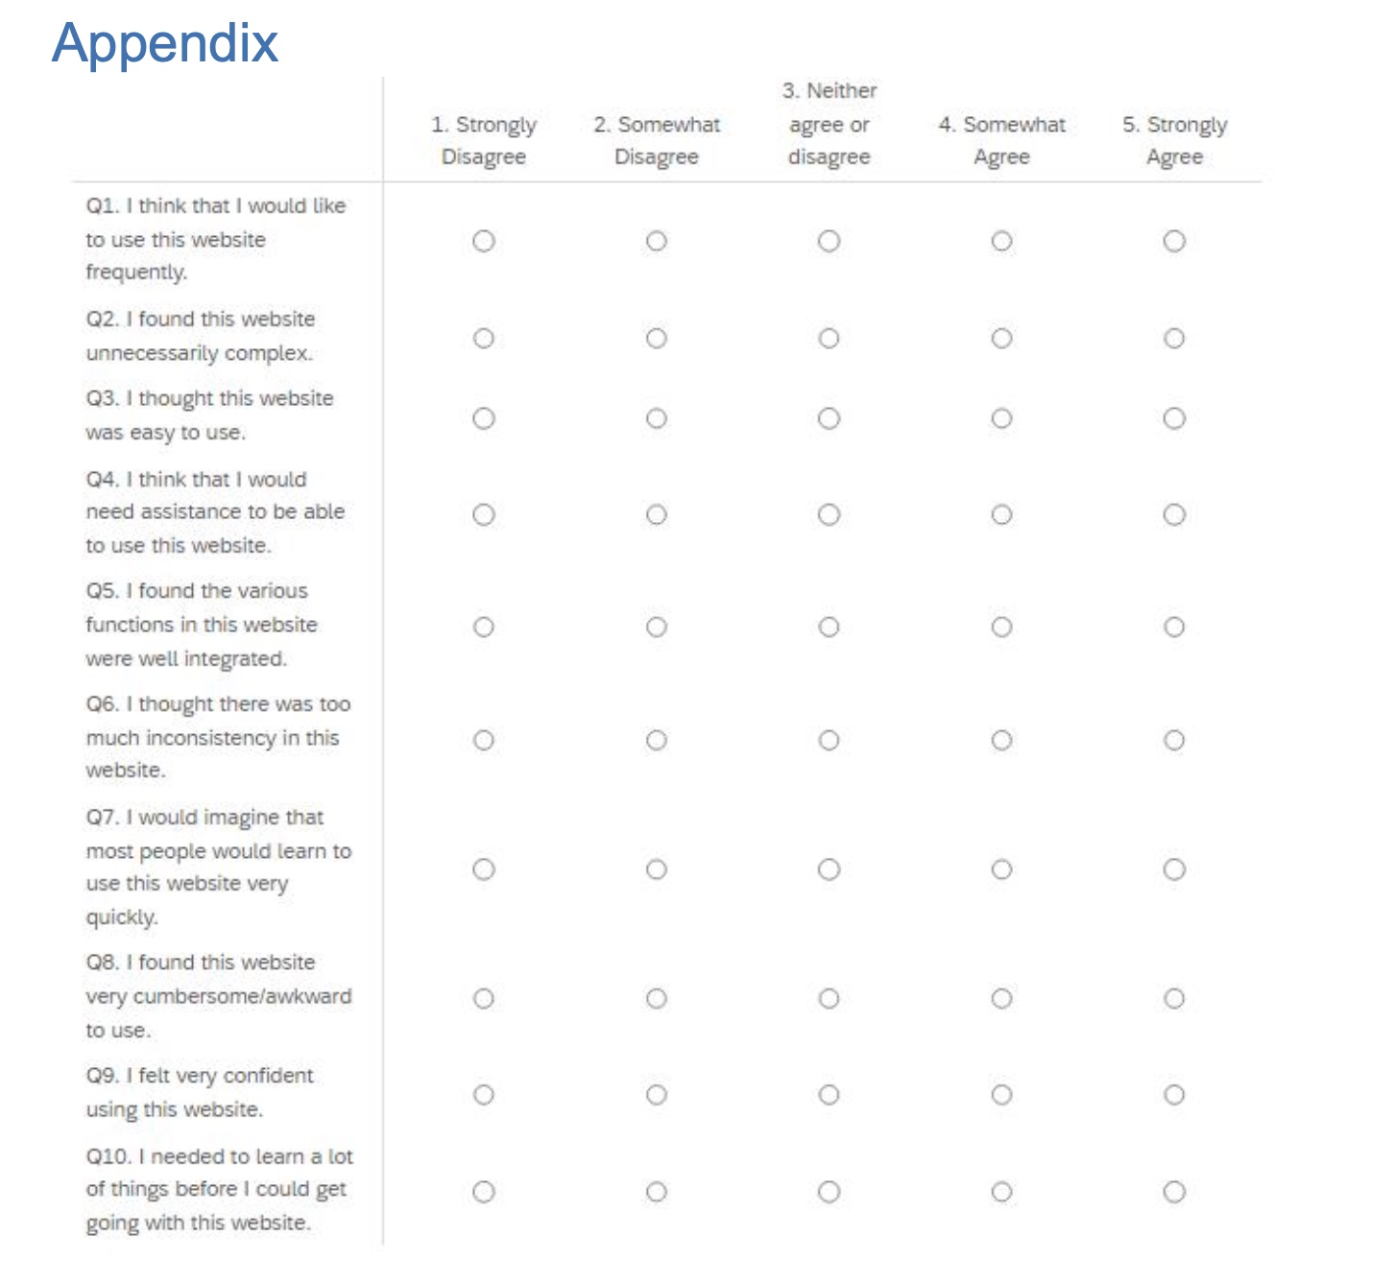

Slide 5
WEBPAGE USER ANSWERS
 | USER 1 | USER 2 | USER 3 | USER 4 | USER 5 | USER 6
QUESTION 1 | 4 | 3 | 5 | 3 | 4 | 4
QUESTION 2 | 1 | 3 | 1 | 2 | 3 | 2
QUESTION 3 | 3 | 4 | 5 | 3 | 5 | 4
QUESTION 4 | 1 | 2 | 1 | 1 | 1 | 1
QUESTION 5 | 5 | 3 | 4 | 5 | 4 | 5
QUESTION 6 | 2 | 1 | 3 | 1 | 2 | 1
QUESTION 7 | 3 | 4 | 5 | 5 | 3 | 4
QUESTION 8 | 1 | 1 | 3 | 2 | 2 | 2
QUESTION 9 | 5 | 4 | 5 | 5 | 4 | 4
QUESTION 10 | 1 | 3 | 2 | 1 | 2 | 1
AVERAGE
4
2
4
1
4
2
4
2
5
2

Slide 6
APP ANSWERS
 | USER 1 | USER 2 | USER 3 | USER 4 | USER 5 | USER 6 | AVERAGE
QUESTION 1 | 4 | 4 | 3 | 5 | 4 | 5 | 4
QUESTION 2 | 1 | 2 | 1 | 1 | 2 | 2 | 2
QUESTION 3 | 5 | 5 | 4 | 4 | 3 | 4 | 4
QUESTION 4 | 2 | 2 | 1 | 1 | 1 | 3 | 2
QUESTION 5 | 4 | 5 | 3 | 5 | 5 | 5 | 5
QUESTION 6 | 1 | 1 | 2 | 1 | 2 | 2 | 2
QUESTION 7 | 3 | 3 | 4 | 4 | 5 | 5 | 4
QUESTION 8 | 1 | 2 | 1 | 1 | 1 | 3 | 2
QUESTION 9 | 5 | 4 | 4 | 5 | 4 | 4 | 4
QUESTION 10 | 1 | 2 | 3 | 3 | 1 | 1 | 2

Slide 7
APP QUESTION RATINGS

Slide 8
WEBPAGE RATINGS

Slide 9

CONCLUSION
After conducting extensive user testing on the group 5 webpage/app, we have gathered valuable insights that will significantly enhance the overall user experience. Throughout the review, a number of aspects were taken into account, including user satisfaction, error rates, task success, usability, and time spent on the work.
The majority of participants said that the website's navigation, design, and layout were user-friendly and were satisfied with the webpage/app.
We will use the outcomes of this user testing to prioritize and implement the necessary improvements. We commit to enhancing the super programmers (group 5) website/app to surpass client expectations and deliver an exceptional user experience. Iterative processes include further testing, ongoing integration of feedback, and design adjustments.
We appreciate the significant contributions from all participants and users, such as testers and prison officers, and look forward to incorporating these modifications to make the Super Coders webpage/app an even better platform for our users.

Slide 10
ETHICAL CONSIDERATIONS
Ethical considerations were crucial in guiding the entire app and webpage development/creation process, especially during the user testing phase. Informed consent was carefully obtained from all participants, outlining the nature of their involvement and the data we would gather, to ensure an open and courteous approach. Strong privacy controls were put in place, with the primary goal being the anonymization of user data. We took in mind the prison system being a smart system has a chance of privacy concerns and data misuse so we prioritized privacy framework in development. Recognizing the value of representative input, we made an effort to keep our participant pool inclusive and diverse however we kept the age range between 18 - 23. Feedback options and constant communication during the user testing were put in place to handle any issues or discomfort consumers might have encountered during testing. Furthermore, we implemented strategies to mitigate potential biases within the testing setting e.g we made sure no comments were made during testing that can change participant answers, upholding equity and equal chances for all individual involved. The ethical framework functioned as a compass, highlighting the importance of user ease, trust , confidence ,privacy during the user testing and eventually fostering a more conscientious and accountable development process for the app and webpage. The teaching office of Lancaster university was also informed about the user testing research and I was finally given consent by the module convenor Mrs. Tracy hall

